Slide 1



PROTOSPHERE WORKSHOP · SECTION 03
IEEE NIRMA STUDENT BRANCH
Communication Protocols in IoT & Embedded Systems
Building Connected Devices with ESP32: Wired Buses, Wireless Networks & Cloud Application Layers
HARDWARE LAYER
WIRELESS LAYER
CLOUD LAYER
UART · I2C · SPI
Wi-Fi · BLE · LoRa
HTTP · MQTT

Slide 2





What Even Is a Communication Protocol?
A Protocol Is Just an Agreement
THINK WALKIE-TALKIE
Who talks first?
A master leads, or peers talk freely
How fast?
Clock speed or baud rate
agree on the rules
Device A
Device B
Where does it begin and end?
Framing: start and stop markers
Did it arrive?
Acknowledgements and checksums
Before anyone speaks, both sides agree how the conversation works. That agreement is the protocol.
Notes:
HOOK (~1 min). Walkie-talkie analogy: before two people can talk on walkie-talkies they agree on who talks first, how fast to speak, how you know a sentence has ended, and what to do if you didn't hear clearly. That agreement IS the protocol.
Chips are no different: the four cards are the four things every protocol settles. The strip at the bottom shows the idea of framing: data is wrapped in markers so the receiver knows where it starts, who it is for, and whether it arrived intact.
Goal: turn 'protocol' from a scary word into something intuitive before the acronyms arrive.

Slide 3
SYSTEM ARCHITECTURE
The 3 Connectivity Buckets
BUCKET 1
BUCKET 2
BUCKET 3
Wired Serial
Wireless RF
Cloud & App
Short-distance chip-to-chip on same PCB board.
Device-to-device and local network RF links.
Once you’re on Wi-Fi, how do you talk to the internet?
UART
I2C
SPI
Wi-Fi
BLE
LoRa
HTTP
MQTT

Slide 4
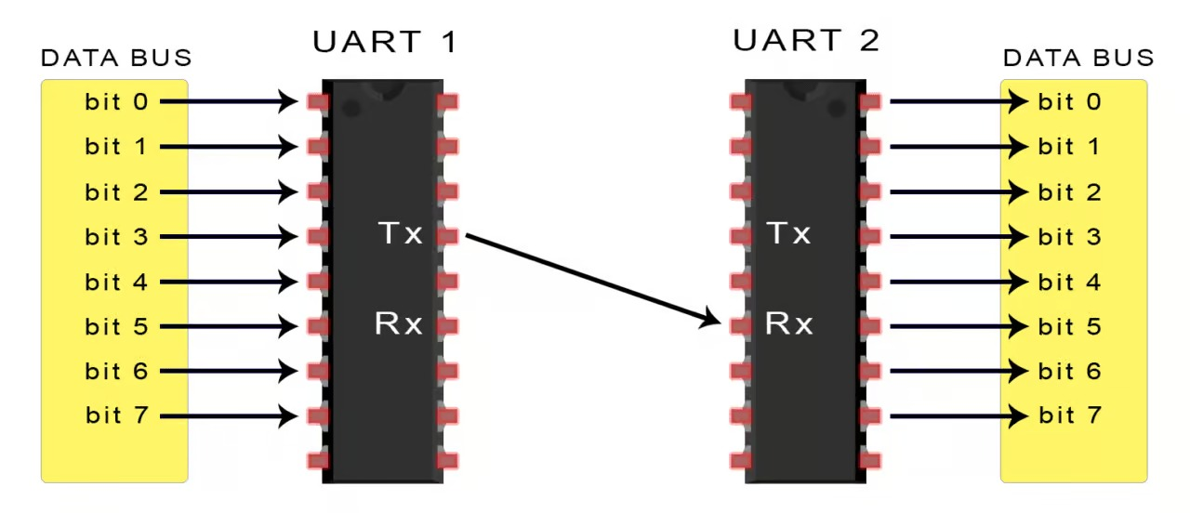
HARDWARE PROTOCOLS
Wired Serial Comparison
UART— the private phone line

Slide 5
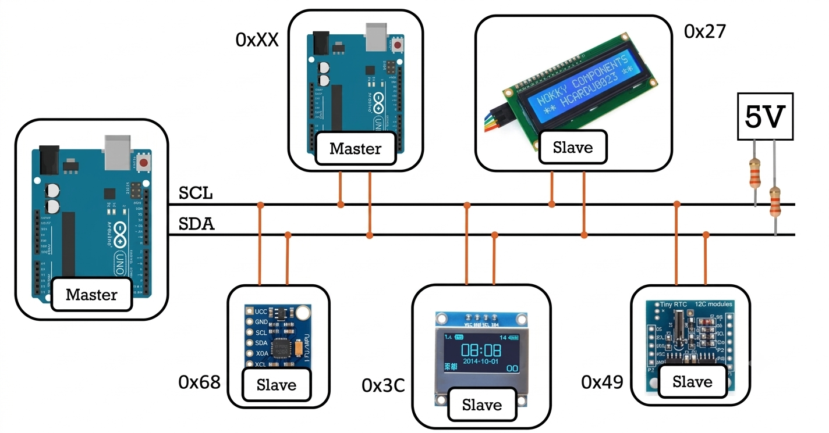
HARDWARE PROTOCOLS
Wired Serial Comparison
2. I2C — the office intercom (slower than SPI)

Slide 6
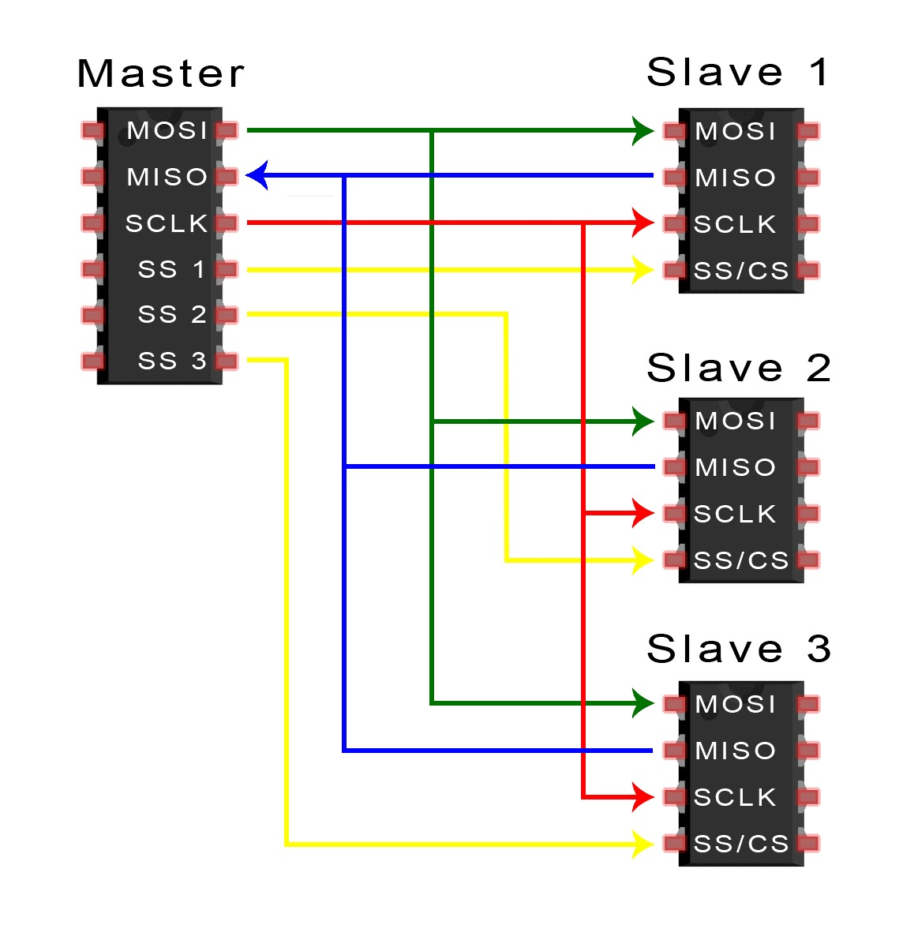
Full Duplex (send and receive at once)
FAST, BUT WIRE GROWS WITH EVERY DEVICE
HARDWARE PROTOCOLS
Wired Serial Comparison
3. SPI — the private courier service

Slide 7
HARDWARE PROTOCOLS
Wired Serial Comparison
Parameter | UART | I²C | SPI
Type | 1-to-1, Asynchronous | Multi-device, Synchronous | Multi-device, Synchronous
Wires | 2: TX, RX | 2: SDA, SCL | 4+: MOSI, MISO, SCK, CS
Typical speed* | ~20 kbps | ~1 Mbps | ~25 Mbps
Distance* | ~15 m | ~1 m | ~20 cm
Best for | GPS, debugging | Multiple sensors | Displays, SD cards, fast sensors

Slide 8







Wireless Protocols Comparison
Wi-Fi
Bluetooth / BLE
Zigbee
LoRa
The highway
The walkie-talkie
The bucket brigade
Shouting across a valley
~10–30 m
kilometres
ESP32
Router
Internet
Phone
ESP32
Fast, straight to the internet
Power-hungry, needs a router
BLE: tiny bursts, sips power
Classic Bluetooth: audio
Nodes relay to neighbours
Self-healing, building-wide
Kilometres of range
Short, occasional messages
USED FOR
USED FOR
USED FOR
USED FOR
Cloud dashboards, OTA updates
Phone control, fitness bands, proximity tags
Smart-home mesh, e.g. Philips Hue
Utility meters, agriculture sensors
Notes:
PERSON B - wireless (~2 min). Four analogies:
Wi-Fi = the highway: huge bandwidth, goes straight to the internet, but a gas guzzler that needs infrastructure (a router). Bad for a coin-cell sensor meant to last months. Use: ESP32 pushing data to a cloud dashboard, OTA updates.
Bluetooth/BLE = walkie-talkies: short range, quick to pair, easy on the battery. Classic Bluetooth = audio/older devices; BLE = tiny infrequent bursts, built for wearables and sensors. Use: ESP32 <-> phone app, fitness bands, proximity tags.
Zigbee = bucket brigade: each node passes the message to its neighbour, forming a self-healing mesh. Use: smart-home mesh (e.g. Philips Hue).
LoRa = shouting across a valley: kilometres of range, but only short, occasional messages. Use: utility meters, agriculture sensors.
Zigbee and LoRa are a brief mention - don't linger.

Slide 9

Wireless at a Glance
PROTOCOL
RANGE
POWER DRAW
SPEED
BEST FOR
Wi-Fi
Internet-connected, data-heavy
~50 m
High
Fast
Bluetooth / BLE
Phone pairing, wearables
~10–30 m
Low
Medium
Zigbee
Smart-home mesh networks
~10–100 m (mesh)
Very low
Low
LoRa
Long-range, infrequent readings
Kilometres
Very low
Very low
Wi-Fi trades power for speed. LoRa trades speed for range.
Bars show relative levels, not exact measurements.
Notes:
PERSON B (~1 min). Read the table as a trade-off map rather than a spec sheet:
Wi-Fi ~50 m, high power, fast - internet-connected, data-heavy.
BLE ~10-30 m, low power, medium speed - phone pairing, wearables.
Zigbee ~10-100 m (mesh), very low power, low speed - smart-home mesh networks.
LoRa km-range, very low power, very low speed - long-range, infrequent readings.
Takeaway line: Wi-Fi trades power for speed; LoRa trades speed for range. The bars are relative, not to scale.

Slide 10
ENGINEERING DECISION MATRIX
Wireless Trade-Off Spectrum
HIGH BANDWIDTH
LOW POWER / SHORT RANGE
LONG RANGE / LOW BANDWIDTH
Wi-Fi
BLE / Zigbee
LoRa
High energy consumption · Router dependent
Coin-cell friendly · Battery lasts months
Kilometer span · Tiny packet updates
Rule of Thumb: You can pick at most 2 out of 3 — High Speed, Long Range, or Low Power.

Slide 11


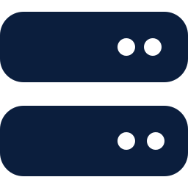

Talking to the Cloud: HTTP vs MQTT
Only relevant once the ESP32 is already on Wi-Fi and needs to reach a server.
HTTP / HTTPS
Ordering at a counter
MQTT
The newspaper subscription
publish
subscribers
full request
full response, then forgets
Ask, wait for the full reply, every time
No memory of the last visit (Stateless)
Simple and universal
Data is shared in packets containing address (Ip address) and a payload
Publishes to a topic; broker fans it out
No polling: subscribers get it instantly
Tiny packets, built for IoT
USED FOR
Live dashboards, home-automation triggers
Notes:
PERSON C (~1.5 min). HTTP/HTTPS = ordering at a counter: you walk up, state your full request, and wait for the full response every time, with no memory of the last visit. Simple and universal, but heavier for constant small updates. Use: occasional readings, calling a REST API.
MQTT = a newspaper subscription: devices publish updates to a topic, and everyone subscribed gets it instantly - no need to keep asking 'anything new?'. Lightweight, tiny packets, low power, built for IoT. Works via a central broker; devices publish/subscribe to topics rather than talking directly to each other. Use: live sensor dashboards, home-automation triggers (if temp > 30C -> fan ON).
One-line mention: CoAP is like HTTP but on a diet, built for constrained devices.

Slide 12
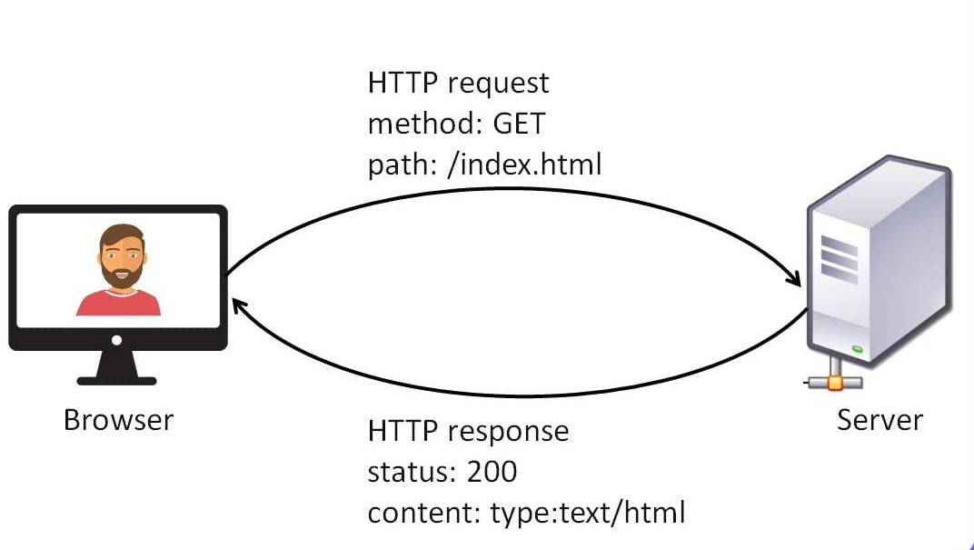
1. HTTP
HTTP status codes
Range | Concept
1xx | Informational
2xx | Success
3xx | Redirection
4xx | Client error
5xx | Server error

Slide 13
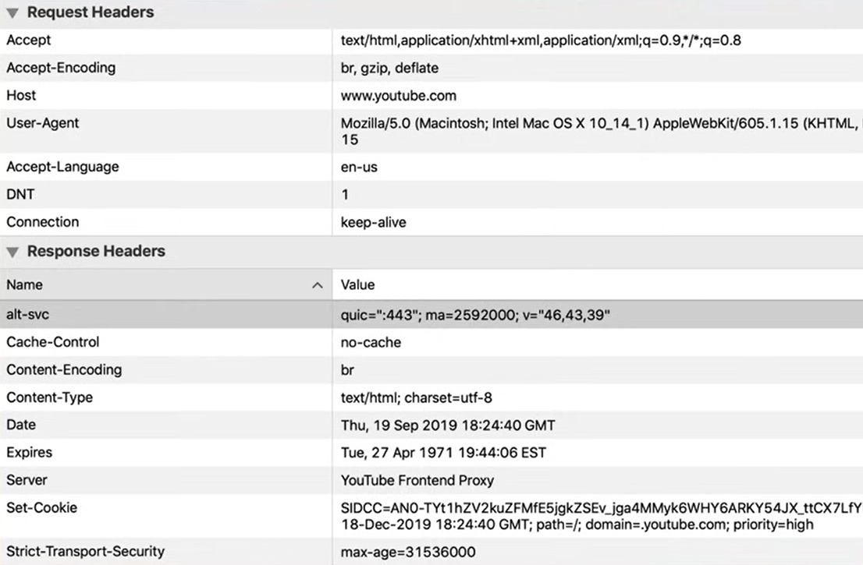

Slide 14
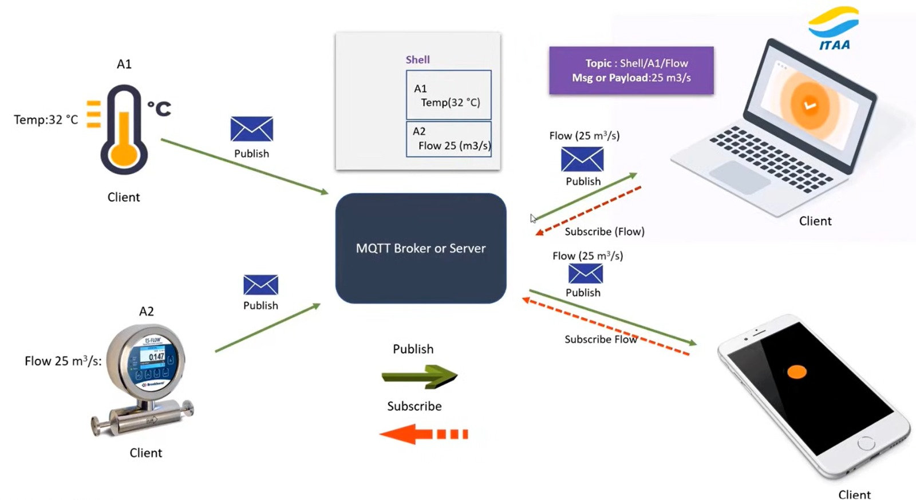
2. MQTT - Message Queuing Telemetry Transport

Slide 15
SYSTEM INTEGRATION
End-to-End ESP32 IoT Data Pipeline
1
2
3
4
5
Sensors
ESP32 MCU
Wi-Fi Link
MQTT Broker
Phone App
I2C / SPI Bus
Processes Data
Local Gateway
Pub/Sub Server
Live Dashboard

Slide 16

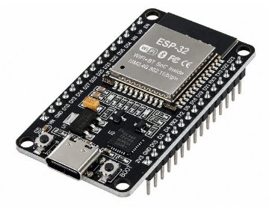
HARDWARE REFERENCE
ESP32 Protocol Pin Cheatsheet
UART0 (Default Serial Monitor)
TX: GPIO 1 | RX: GPIO 3
Flashing & debugging serial output
I2C Default Bus
SDA: GPIO 21 | SCL: GPIO 22
Sensors, RTCs, OLED displays
SPI Default Bus (VSPI)
MOSI: 23 | MISO: 19 | SCK: 18
SD card modules, color TFT screens

Slide 17
HANDS-ON SEXAMPLE
Use-case & Activities Example
DEMO 01
DEMO 02
DEMO 03
I2C Bus Scanner
Smartphone Web Control
Live Cloud Telemetry
Flash an I2C scanner sketch to auto-detect sensor addresses (0x68, 0x3C) live on the serial monitor.
Host a tiny HTTP server on the ESP32 and toggle board LEDs straight from your phone browser.
Publish real-time temperature data to a public MQTT broker and watch live charts update automatically.
Wire.begin()
WiFiServer(80)
client.publish()
Questions & Discussion
ieee.nirma@example.edu
@ieee_nirma

